Slide 1
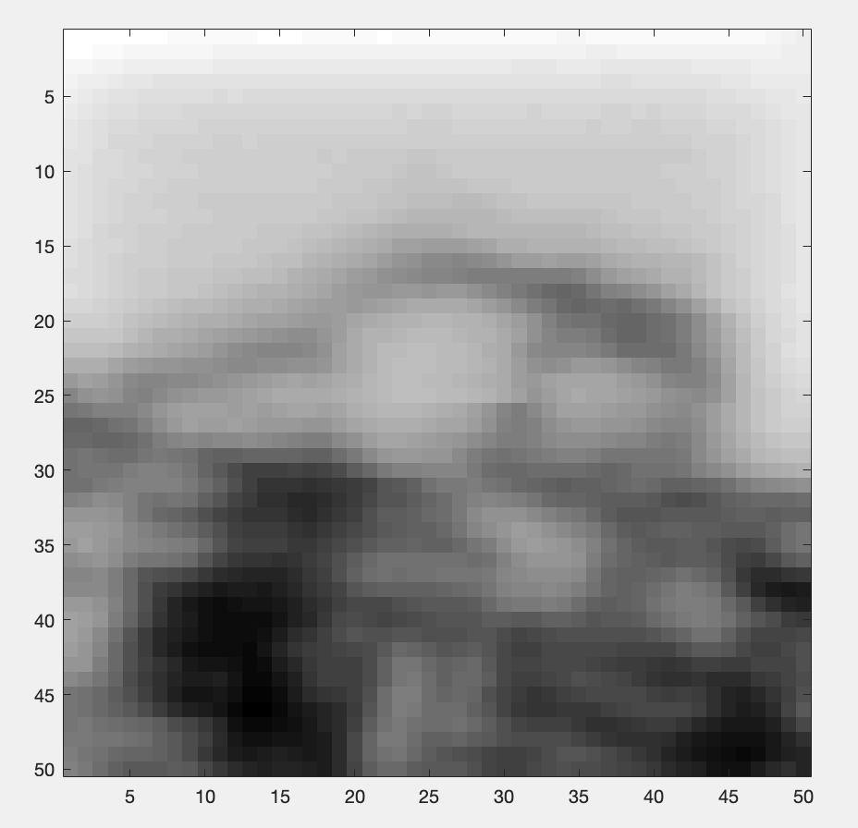
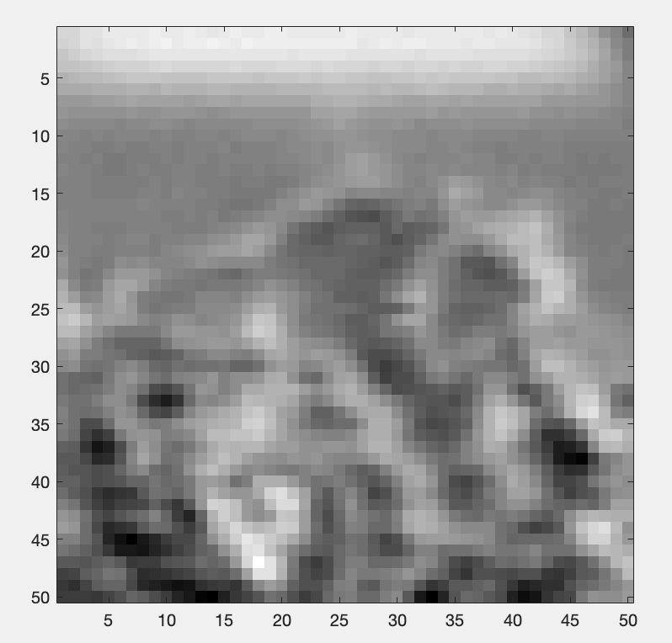
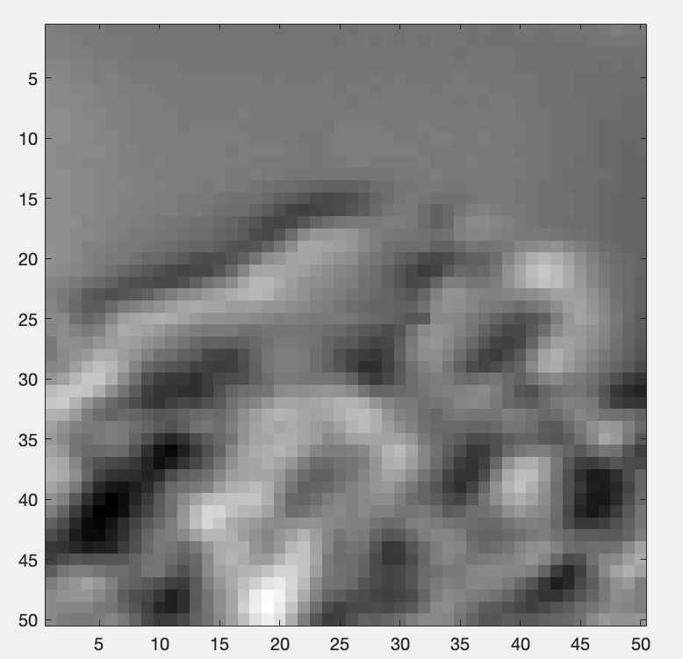
STXM images
Horizontal differential phase contrast
Vertical differential phase contrast
Absorption

Slide 2
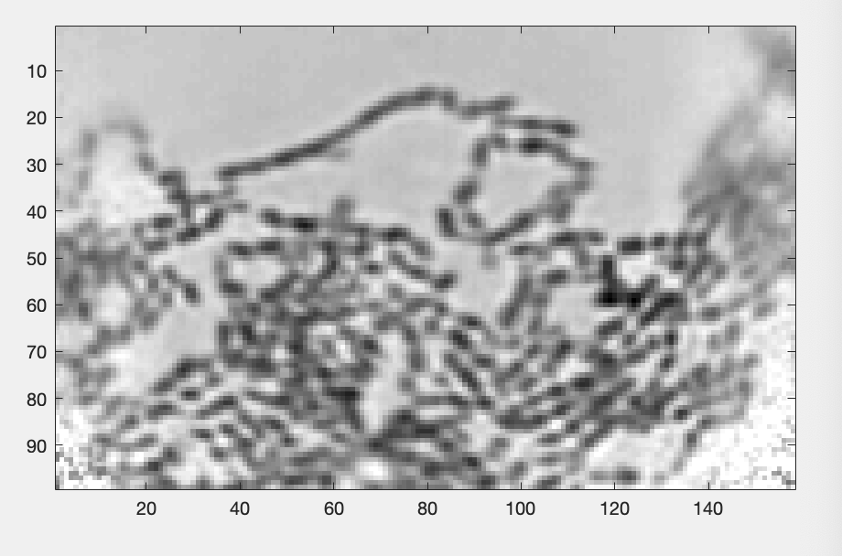
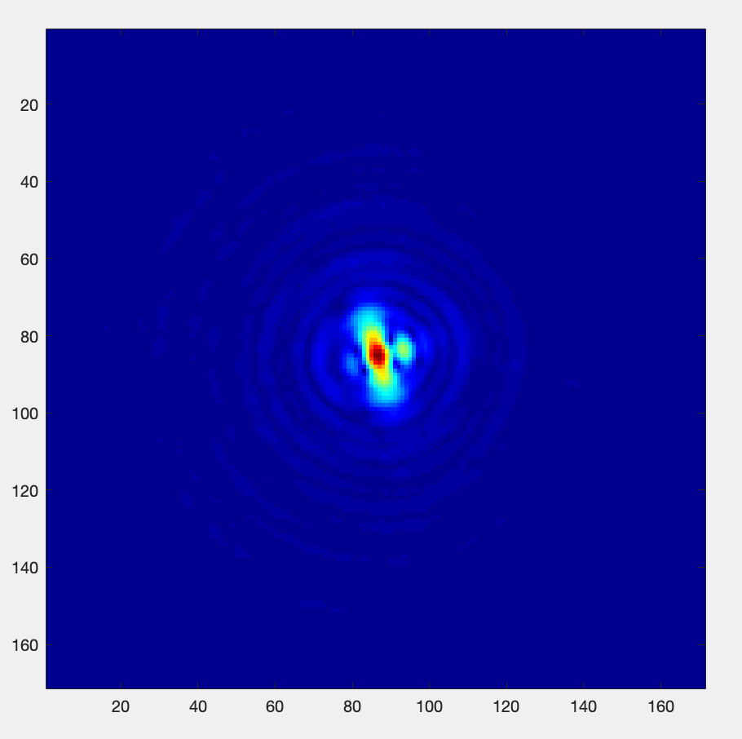
Ptychography reconstruction
Amplitude
Amplitude Probe
Nb of iteration : 30

